Slide 1


HoopFinder
Iteration 1

Slide 2
What is HoopFinder?
Hoopfinder is an app that helps facilitate basketball players meeting up to play.

Slide 3
Requirements
Functional
Users can and must register to use the app
App fetches location of all users at a specified interval
App knows location of all courts
App alerts user when the user is near a court and another user
Users can subscribe to locations to know when players are nearby
Optional
Users can enter pre-arranged tournaments through the app
Users can add new courts to the app’s database
Users can subscribe to other users

Slide 4
Metrics
 | 0 | 1 | 2 | 3 | 4 | 5
# hours worked | 15 | 25 | - | - | - | -
# defects | 0 | 0 | - | - | - | -
# lines of code | 0 | 34 | - | - | - | -
# features added | 0 | 1 | - | - | - | -
# class files | 0 | 3 | - | - | - | -

Slide 5
Progress
Completed
App fetches location of the user
In progress
Notifications can be sent
Users can register for the app using email or Facebook
Create database tables to hold user information and basketball court location

Slide 6
Issues
android vs. androidx imports
Need to finalize class organization
Need to decide what action to allow users to do after a proximity notification is sent

Slide 7
Design

Slide 8
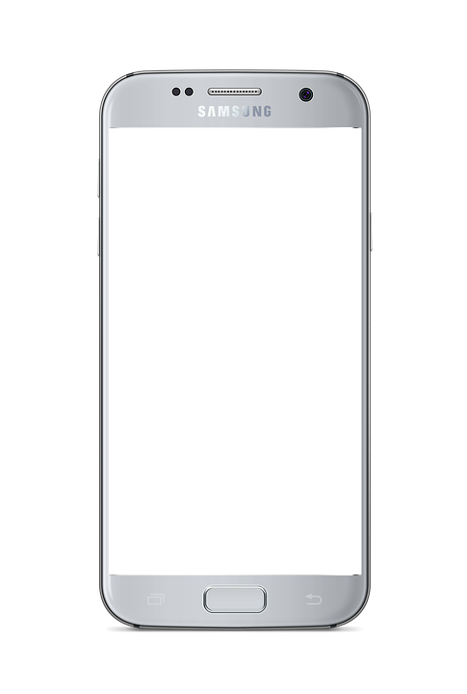
HoopFinder
Username
Password
LOGIN
New user?

Slide 9
HoopFinder
Username
Password
Confirm password
REGISTER

Slide 10
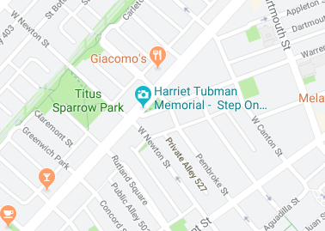


HoopFinder
MAP
FRIENDS
1 court near you!
3 ballers nearby

Slide 11
HoopFinder
MAP
FRIENDS
Friends
jumpinjack
speedsteve
hooper312
hgtwb88
ADD FRIENDS

